Slide 1

Background & Goals
LENDus.com

Slide 2
Process Flow
Collect
Clean
Explore
Model & Interpret

Slide 3

Collect data
.

Slide 4
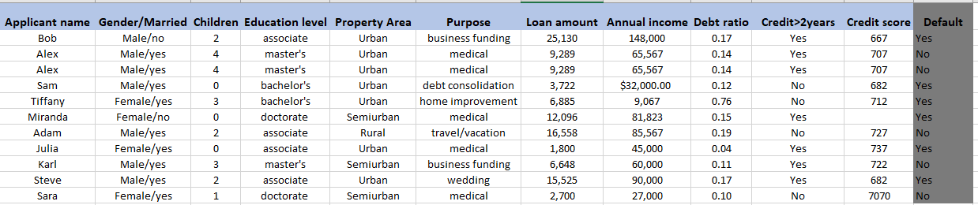
Loan Approval Data (12 columns X 3000 rows)

Slide 5

Clean data
Irrelevant columns
Empty cells
Wrong format
Wrong data points
Outliers
Duplicate rows

Slide 6

Explore data (visual & non-visual)
Type of each variable
Characteristics of variables
Shape/pattern of variables
Trends
Relationship between the variables

Slide 7
Variable data type
Children(0,1,4 ,…)
Education level(associate, master’s, …)
Property Area(Urban, Semiurban, …)
Annual income(23,000, 9000, …)

Slide 8
Variable shape and characteristics

Slide 9
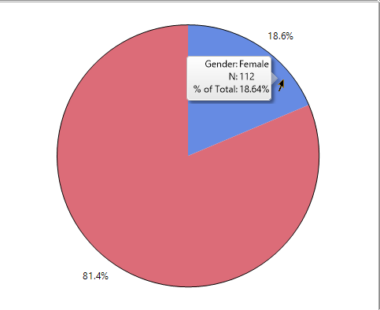

Slide 10
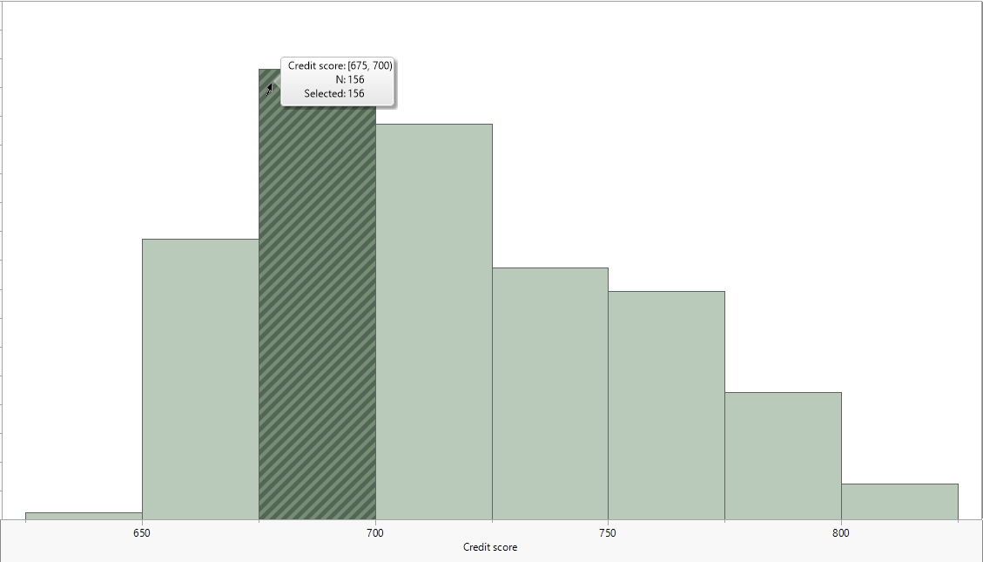

Slide 11
Credit Score 0.8 -0.7 | Descriptive Stats
0.8 | Mean(avg) | 715
-0.7 | Std Dev | 39
 | Min | 627
 | Max | 822

Slide 12
Relationship between variables
Variables | Correlation(-1,1) | Shape
Annual income, Credit score | +0.8 | ↑↑
Children, Loan amount | -0.7 | ↑↓

Slide 13

Model & Interpret
A model that predicts whether an applicant will default or not.
A model that Puts past applicants into groups.

Slide 14
Features
Target

Slide 15



Annual Income: $32,000
Loan amount: $120,000
Rejected
Default: Yes
Children: 3
Alex
Annual Income: $44,000
Approved
Loan amount: $90,000
Default: No
Children : 0
Jessica

Slide 16

Model Training

Slide 17
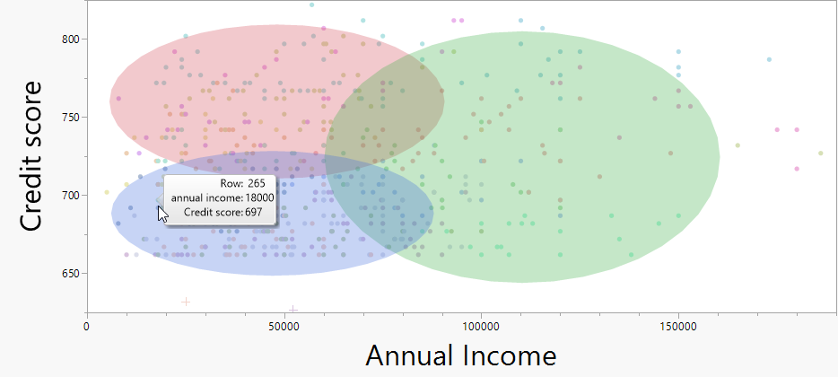
Grouping applicants

Slide 18
Process Flow
Collect
Clean
Explore
Model & Interpret

